Slide 1
The Role of Intuition in Evidence-Based Design
European Healthcare Design Conference, 17-19 June 2019, London
D. Kirk Hamilton, Beale Professor, Texas A&M University, USA
Stefan Lundin, Architect and Partner, White Arkitekter, Sweden

Slide 2
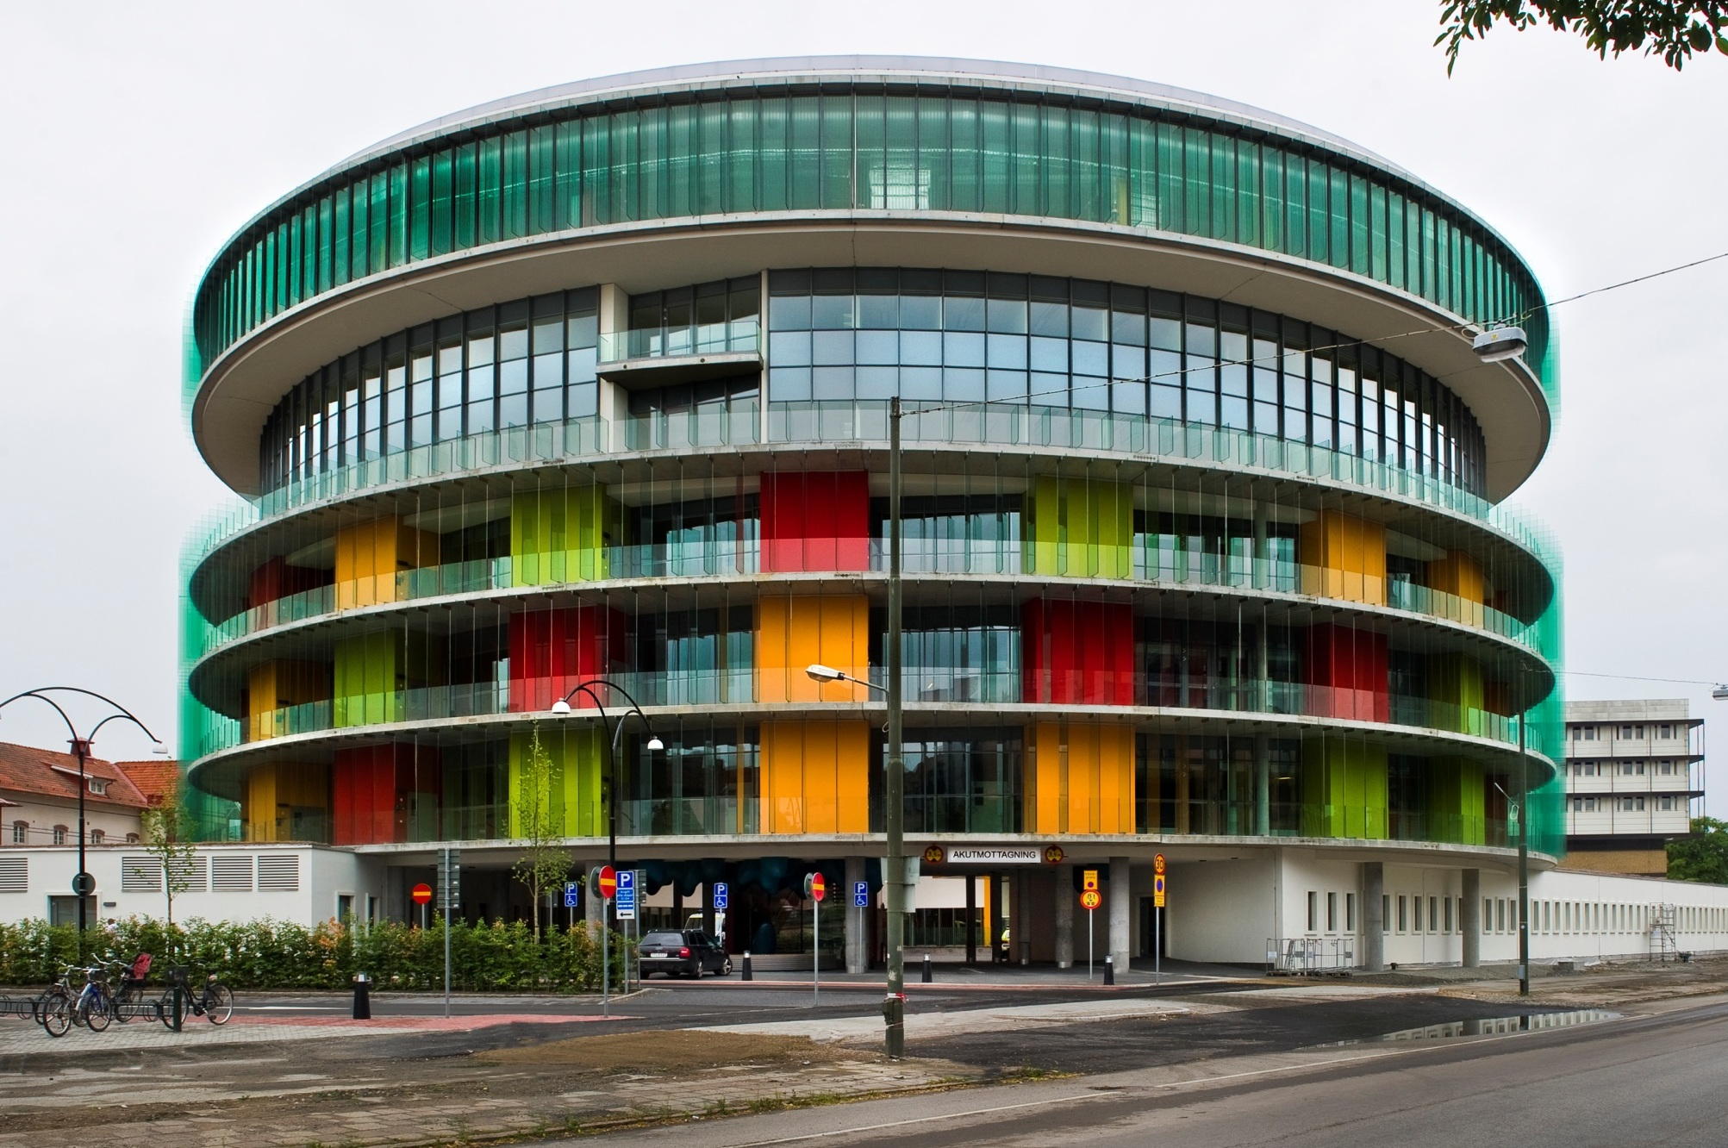
Skåne University Hospital, Malmö, Sweden
Architect: C.F. Møller, Aarhus, Denmark
Notes:
The infectious disease hospital in Malmo, Sweden deals with critical, life-threatening conditions. Evidence led them to admit patients directly from outdoors, entering rooms from the exterior open air balconies without passing through a hospital lobby.

Slide 3
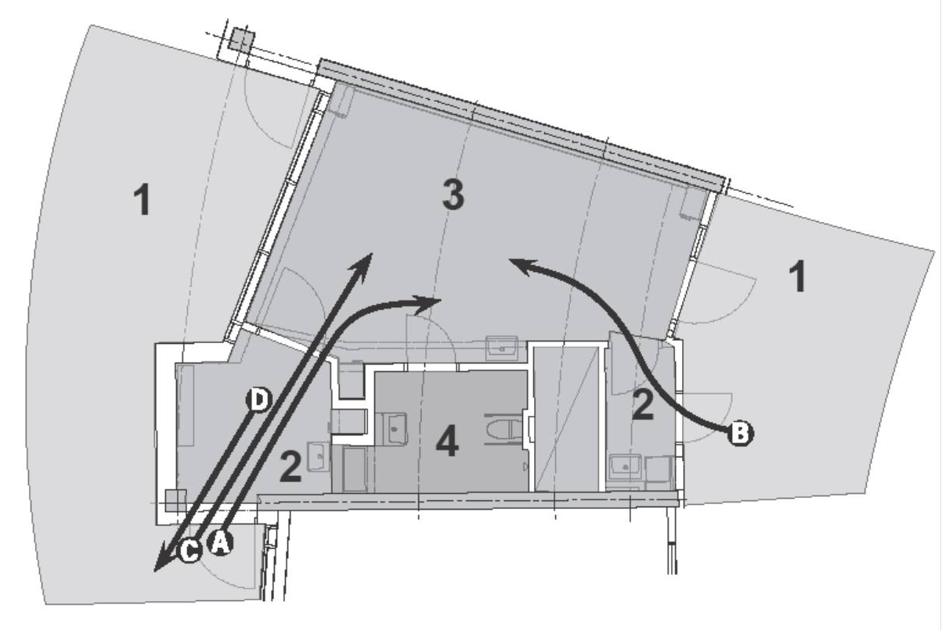
exterior balcony
1-bed patient room
staff corridor
anteroom
entry
patient toilet
staff anteroom
Notes:
The patient room is an evidence-based design that protects others from the infectious organisms with a pair of anterooms, air pressure controls, and a macerator in the toilet.

Slide 4

Notes:
While the design uses evidence to protect patients & staff from infection, the building form and choice of colors are intuitive and aesthetic. The building is a nice mix of evidence-based and intuitive design decisions. Evidence and intuitive architecture are ‘walking hand-in-hand’ here.

Slide 5
What is Evidence-Based Design?
“Evidence-based design is the conscientious, explicit and judicious use of current best evidence from research and practice in making critical decisions, together with an informed client, about the design of each individual and unique project.” Hamilton, 2007, 2008, 2009
  making decisions
  individual projects
  current best evidence
Notes:
In the 1980s architects took note of research connecting design to clinical outcomes, through the work of pioneers like Roger Ulrich, and by the 1990s the medical field was developing the concept of evidence-based medicine. Evidence-based design soon followed as an analogous concept tying design to clinical outcomes.

Slide 6
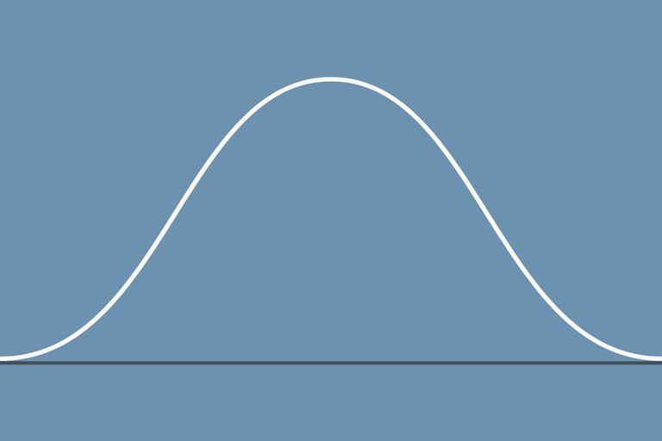
Design Decisions: Number / Project
Best Practice
Majority of Decisions
Evidence-Based
Our 2010 Thinking:
Conflict?
Intuitive
Hamilton’s
Advocacy
Lundin’s
Advocacy
Notes:
While Hamilton has long advocated for the rigor of evidence-based design decisions, Lundin has explored the role of the designer’s intuition. Both are needed, and the majority of design decisions will still be made on the basis of consensus-based best practice.

Slide 7
Design Decisions: Number / Project
Best Practice
Majority of Decisions
Hamilton’s
Advocacy
Lundin’s
Advocacy
Evidence-Based
Dialogue
Intuitive
Notes:
While Hamilton has long advocated for the rigor of evidence-based design decisions, Lundin has explored the role of the designer’s intuition. Both are needed, and the majority of design decisions will still be made on the basis of consensus-based best practice.

Slide 8
Design Decisions: Number / Project
Best Practice
Majority of Decisions
Hamilton’s
Advocacy
Lundin’s
Advocacy
Evidence-Based
Intuitive
Our 2019 Thinking:
Agreement!
Notes:
While Hamilton has long advocated for the rigor of evidence-based design decisions, Lundin has explored the role of the designer’s intuition. Both are needed, and the majority of design decisions will still be made on the basis of consensus-based best practice.

Slide 9
Knowledge in Practice
Conscious/reflective knowledge
Evidence
Shared knowledge
Accepted/consensus knowledge
Best Practice
Experience based personal knowledge
Ordinary Practice
Personal knowledge
Personal unconscious, unreflective knowledge
Intuition
Subjective, random, uninformed
Arbitrary Choice
Absence of knowledge
Adapted from S.Lundin, 2015 PhD Thesis, Chalmers Technical University
Notes:
Some see a conflict between evidence and intuition, but both are valid. Intuition is based upon tacit knowledge and experience. The problem is arbitrary, subjective, and uniformed design decisions.

Slide 10
What Is Increased Rigor in Design?
Serious search for relevant evidence
Chain of logic: evidence to design concept
  Critical thinking, careful interpretation
Hypothesize expected outcomes
  Document design intent in advance
Commit to measure outcomes
  Use of appropriate methods
Share knowledge gained
Notes:
A small number of design decisions on a project may need to involve a search for relevant evidence, and its interpretation to develop design concepts. The outcomes associated with implemented concepts should be measured, and the results shared to advance the field.

Slide 11
Intuition & Creativity
Making a few important decisions on the basis of research findings does NOT mean ignoring creativity
Creativity & intuition are required to interpret the implications of research linking design and clinical outcomes
Multiple design decisions are made intuitively on topics that appear to require no evidence
Aesthetic creativity is still cherished!
Notes:
An evidence-based design process does NOT rule out intuitive and aesthetic design decisions.

Slide 12
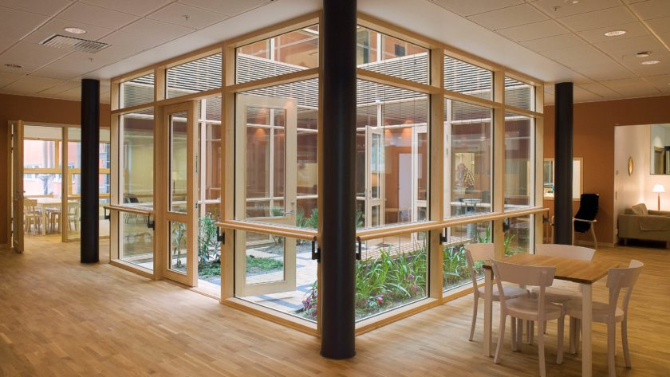
Östra Hospital Acute Psychiatry Ward, Göteborg, Sweden
Architect: White Arkitekter
Notes:
The Östra psychiatry ward project was a separate part of a larger hospital. The residential behavioral health facility received very positive recognition and awards. The designer, Stefan Lundin, declared most decisions were based on experience and intuition.

Slide 13
Östra
The Östra project was celebrated by Roger Ulrich for including all but one known evidence-based concept for behavioral health facilities.
The architect, Stefan Lundin of Sweden’s White Architects, had not been aware of the research or the evidence.
He proclaimed that the success was based upon experience and intuition!
Notes:
Ulrich congratulated Lundin for using the known evidence-based concepts, yet Lundin arrived at them without knowledge of the evidence.

Slide 14
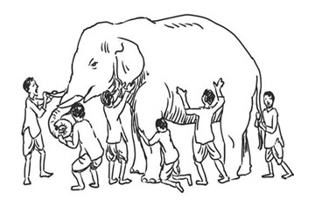
Parable: Blind Men & the Elephant
design must be based on logic & evidence
but design has always been based on art & intuition
best practice still solves most design issues

Slide 15

Parable: Blind Men & the Elephant
Creative & Intuitive Concepts
Best Practice
Fire & Safety Regulations
Building Materials Research
Equipment Testing
Infection Control
Waterproofing
Lighting Design
Mechanical Engineering
Structural Engineering
Clinical Outcome
Evidence
Civil Engineering Foundations
Notes:
Each project has aspects where Intuitive or evidence-based decisions may be made, but the vast majority of decisions are based on Best Practice

Slide 16

Dublin Methodist, Dublin, Ohio
evidence-based does not mean mundane architecture…
Architect: Karlsberger & CAMA, Inc.
Notes:
Many design decisions at Dublin Methodist were based on interpretation of evidence, yet numerous decisions about form and choice of materials were made on the basis of intuition and creativity.

Slide 17
Dublin Methodist, Dublin, Ohio
• Accessible roof areas (elevated)
• Acoustic environment
• Acuity-adaptable rooms
• Bathroom on headwall with handrail
• Distributed staff work stations
• Internal courtyards (non-elevated)
• Large doors in patient rooms
• Large doors in patient bathrooms
• Large private rooms with family space
• Natural light in 90% of occupied spaces/Lighting
• Like-handed rooms
• Water feature in lobby
• Well-located hand hygiene stations
Evidence-Based Design
Features
Opened January 2008
Notes:
While many design concepts were based upon interpretation of evidence, and the building form and choice of materials were creative and intuitive, the majority of design decisions were based upon best practice.

Slide 18
Where is the Art?
Domain of
Highest Creativity
DISCOVERY & ORIGINAL CRITICAL THINKING
SUBJECTIVE & CREATIVE
little known
low impact
little is known
decision
is important
high
Area of Maximum Design Freedom
Degree of
Uncertainty
good information
low impact
good information
important decision
low
OBJECTIVE & SIMPLE
OBJECTIVE & DEMANDING
low
high
Impact of Decision
Notes:
Stefan believes creativity is required in all four quadrants. Involving the client in dialogue is a way to avoid the arbitrary.

Slide 19
Discussion
How do you gain new knowledge to support innovation?
Do you make intuitive design decisions?
Are you using tacit knowledge?
Are you involved in design dialogue with the project stakeholders?
Does design dialogue help avoid arbitrary decisions?

Slide 20
The Role of Intuition in Evidence-Based Design
Thank you!
khamilton@tamu.edu
stefan.lundin@white.se
European Healthcare Design Conference, 17-19 June 2019, London

